Slide 1








Integration Online e-Commerce (Omnichannel), Delivery System with ERP Application
Unifying Digital Commerce for Enhanced Business Performance
2025-10-16

Slide 2



Agenda
Introduction: Unifying Digital Commerce
Integration sample Shoppe e-Commerce with ERP By Infinyscloud
Integration local e-Commerce (by ERP infinyscloud), with sample Delivery API Raja Ongkir
Sample Reporting & Dashboard
Future-Proofing Your Business

Slide 3
Unifying Digital Commerce

Slide 4









Introduction: Unifying Digital Commerce
In today's rapidly evolving digital landscape, the seamless integration of Enterprise Resource Planning (ERP) systems with eCommerce platforms has become paramount for businesses aiming to optimize operations and enhance customer experiences.
Operational Efficiency
Customer Experience
Business Growth
Streamlined processes reduce manual effort and minimize errors in the order-to-cash cycle.
Consistent product information and order status across all touchpoints builds customer trust.
Integrated systems provide a foundation for scalability and future expansion.
Focus on ERP by Infinyscloud
This presentation explores how ERP by Infinyscloud serves as an integration hub, bridging ERP and eCommerce systems to create a unified digital commerce ecosystem.

Slide 5














The Synergy of ERP and eCommerce
In today's rapidly evolving digital landscape, businesses face increasing pressure to deliver seamless customer experiences while maintaining operational efficiency. This necessitates bridging the gap between customer-facing sales channels and internal operational systems.
Enterprise Resource Planning
eCommerce Platform
Internal operations management
Customer-facing sales channel
Strategic Integration Benefits
Centralized Data
Streamlined Operations
Enhanced Customer Experience
Single source of truth across all business operations.
Automated processes reduce manual effort and errors.
Consistent and personalized interactions across all touchpoints.
Key Insight: Integration of ERP and eCommerce is no longer a luxury but a strategic imperative for sustained competitiveness and growth.

Slide 6











Strategic Benefits & Operational Challenges
Strategic Benefits
Operational Challenges
Centralized Data Management
Initial Implementation Costs
Unified system with "single source of truth" across all business operations.
Significant upfront investment in software and customization for complex integrations.
Streamlined Order Processing
Data Migration Complexities
Automated order capture, fulfillment, and invoicing reduce errors and accelerate the order-to-cash cycle.
Time-consuming data transfer from disparate systems requires careful planning.
Real-time Inventory Accuracy
Process Re-engineering
Synchronized inventory prevents overselling and improves stock management.
Redesigning workflows to align with new systems can be disruptive in the short term.
For growing businesses, the strategic benefits of ERP-eCommerce integration significantly outweigh the operational challenges.

Slide 7













ERP By Infinyscloud as the Integration Hub
ERP by Infinyscloud is a comprehensive, open-source ERP solution distinguished by its modular architecture, making it an exceptional platform for seamless eCommerce integration.
eCommerce
CRM
Inventory
Online store management
Customer relationships
Stock management
Odoo
Hub
Accounting
Delivery
Analytics
Financial transactions
Delivery transaction
Reporting & Dashboard
Modular Flexibility
Unified Management
Select and integrate specific applications as needed.
All business operations managed within a single system.

Slide 8
















Core ERP Modules for eCommerce
Odoo's modular architecture allows businesses to select and integrate specific applications as needed, making it an exceptional platform for seamless eCommerce operations.
Sales
Inventory
Accounting
CRM
Website/eCommerce
Manages sales orders, quotations, and customer invoicing.
Tracks stock levels, manages warehouses, and automates reordering.
Handles financial transactions, invoicing, payments, and reporting.
Manages customer relationships, leads, opportunities, and support.
Creates and manages online stores, product catalogs, and customer portals.
Online e-Commerce : such as Tokopedia / Tiktok, Blibli, Shopee
Odoo Integration Benefits
Centralized data management
Streamlined order processing
Real-time inventory accuracy
Enhanced customer experience

Slide 9
Integration sample Shoppe e-Commerce with ERP By Infinyscloud

Slide 10
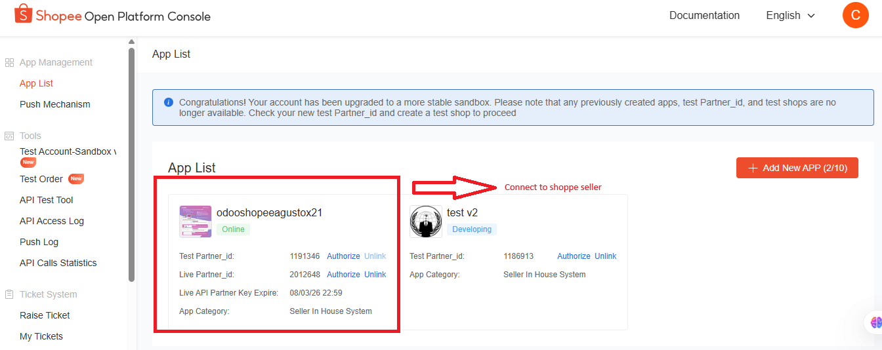
Open.Shopee.com
open.shopee.com is the Shopee Open Platform, a portal for developers to build apps and services that integrate with Shopee's e-commerce platform. It provides APIs for managing orders, products, and marketing, along with tools and resources for app development, testing, and maintenance for sellers. The platform is designed to help developers and sellers streamline operations and create new business opportunities.
Odoo
Hub

Slide 11
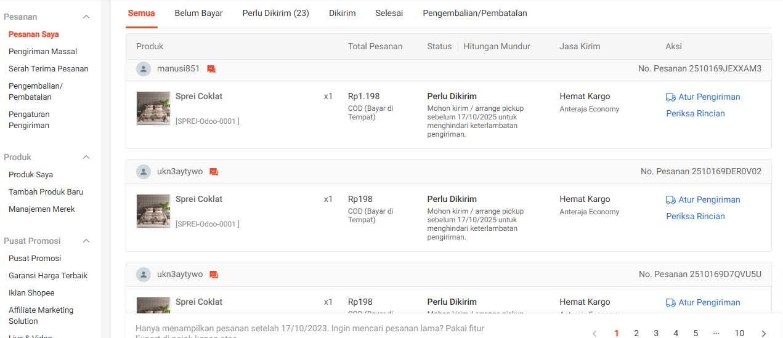
seller.shopee.co.id
A web portal and management hub that allows sellers to oversee and operate their online stores on the Shopee e-commerce platform.
Sellers use this platform to manage all aspects of their business, from inventory to sales analysis.
Key functions of the Shopee Seller Centre include:
Product management: Sellers can upload, edit, or remove product listings and track their inventory levels.
Order processing: The site provides tools to view incoming orders, arrange shipments, and monitor delivery status.
Promotion management: It offers features to create and manage marketing campaigns, such as discount vouchers and special offers, to attract more buyers.
Store settings: Users can update their store information, customize the shop's appearance, and configure various settings. Sellers use this platform to manage all aspects of their business, from inventory to sales analysis.
etc.
Odoo
Hub

Slide 12
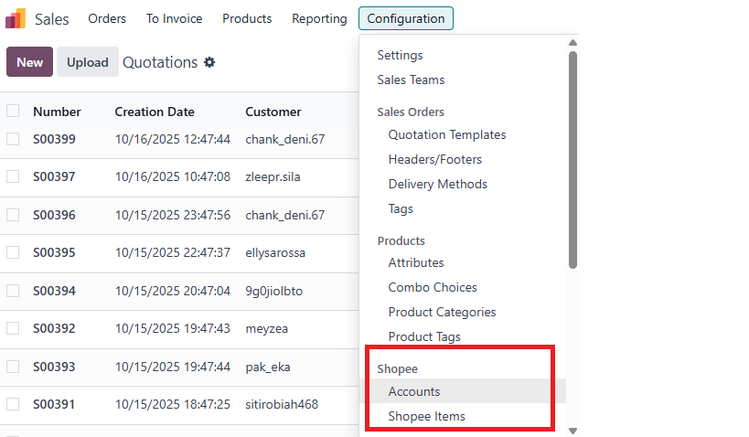
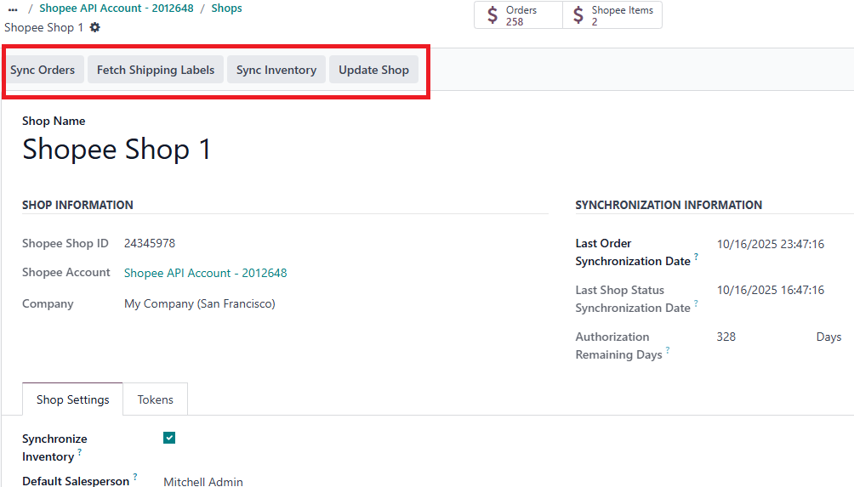
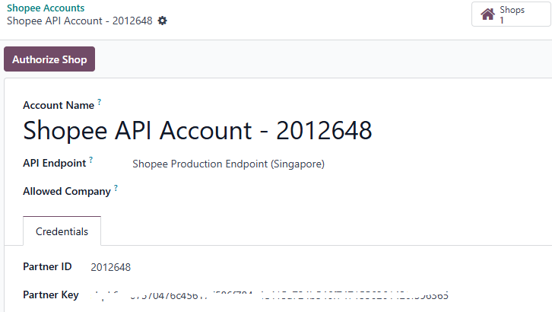
Setting shopper integrate to ERP InfinysCloud
1
3
Odoo
Hub
2
Manual Synchronization : we can do manual sync with click those 4 buttons are Sync Order, Fetch Shipping Labels, Sync Inventory & Update Shop
Automatically Synchronization : by default yes, and we can adjust the time interval for sync on the menu schedule actions

Slide 13
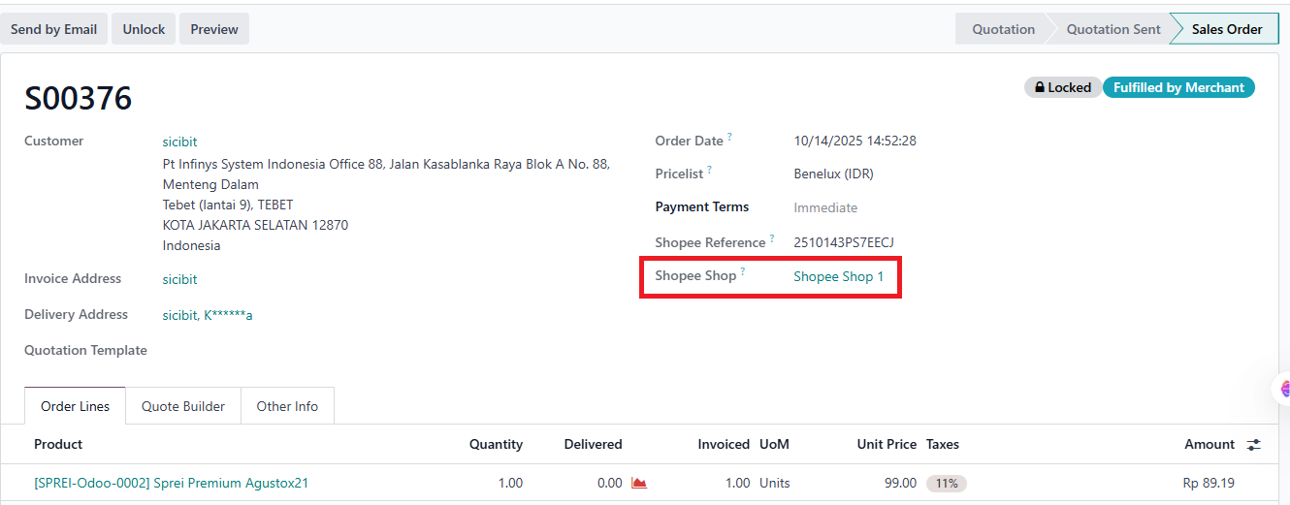
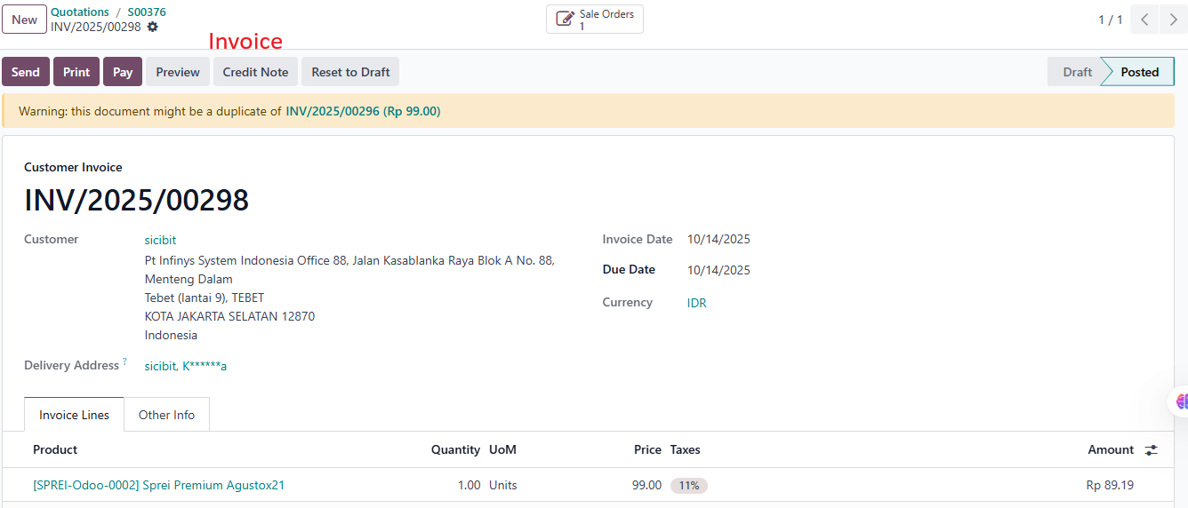
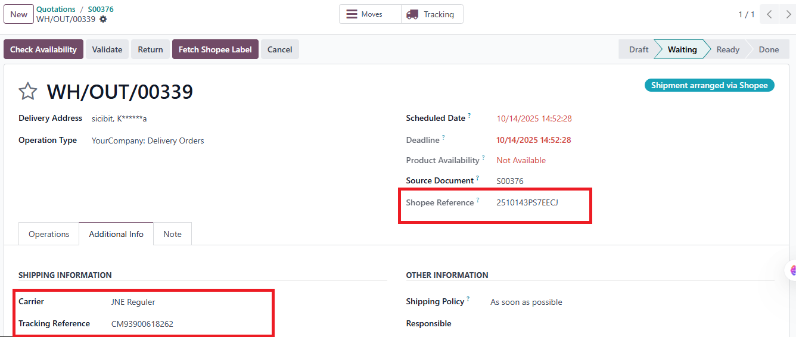
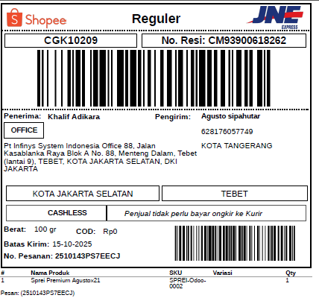
Sample 1 Transaction : SO – DO – Invoices & DO Receipt (Resi)
1
3
Odoo
Hub
4
2

Slide 14
Integration local e-Commerce (by ERP infinyscloud), with sample Delivery API Raja Ongkir

Slide 15
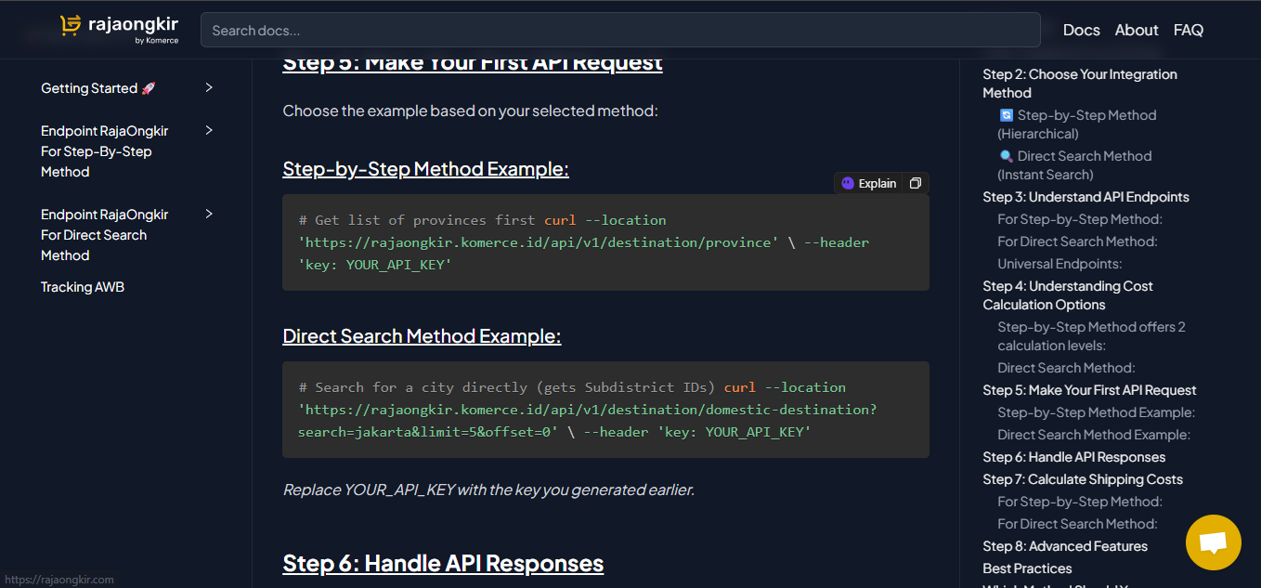
Raja Ongkir
RajaOngkir is an API-based platform that provides shipping cost data from various courier services in Indonesia (e.g., JNE, TIKI, SiCepat, POS Indonesia).It allows Odoo eCommerce to automatically calculate shipping rates during checkout without manually checking courier websites.
Odoo
Hub

Slide 16
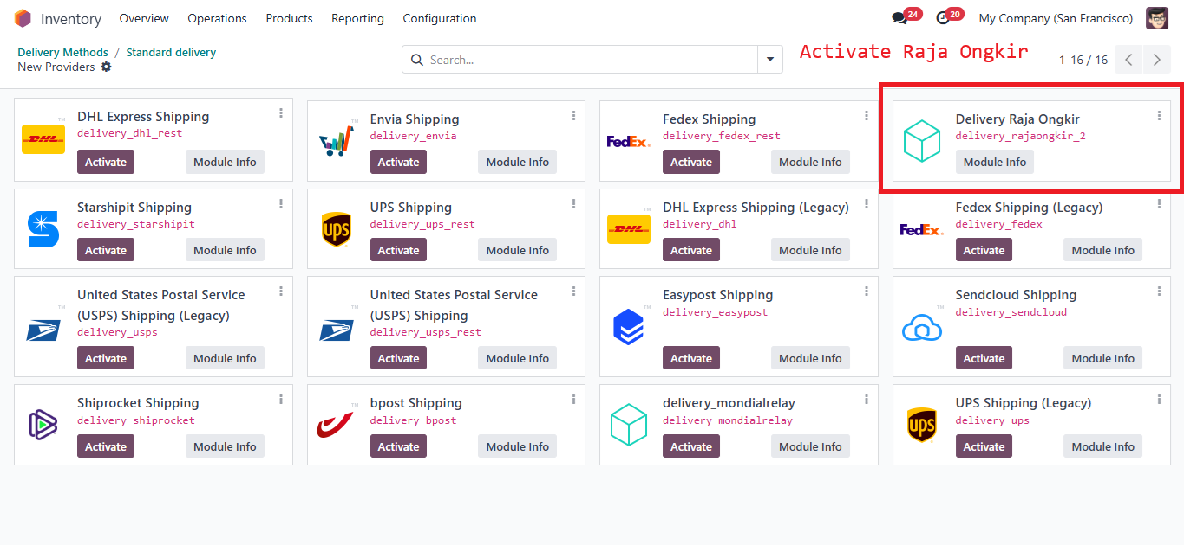
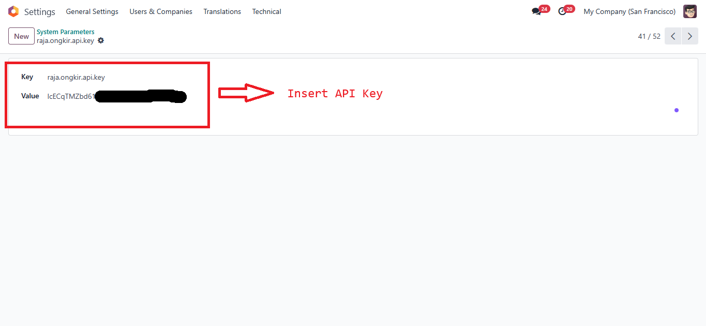
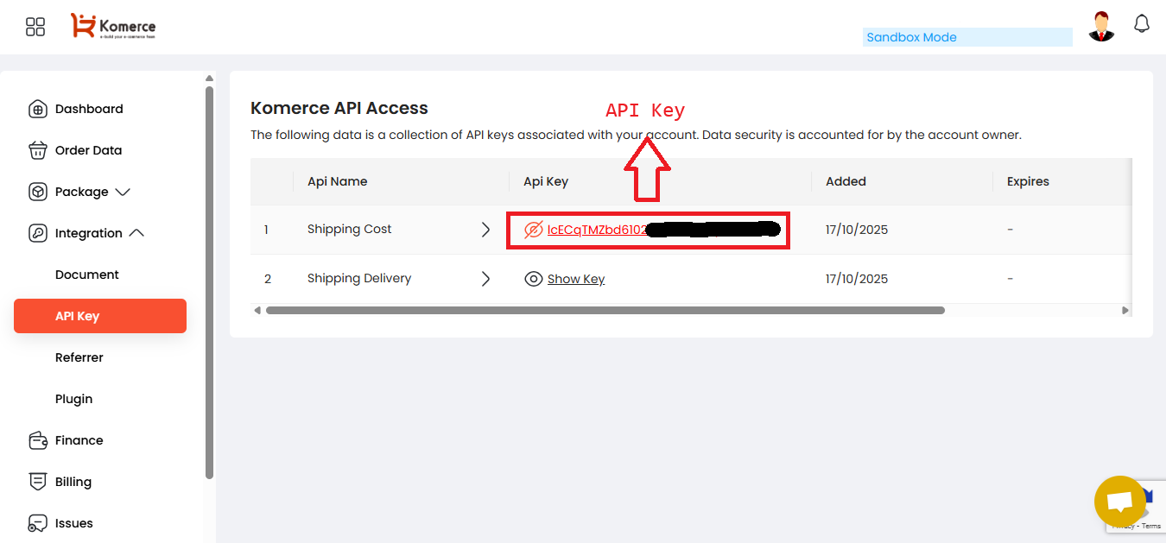
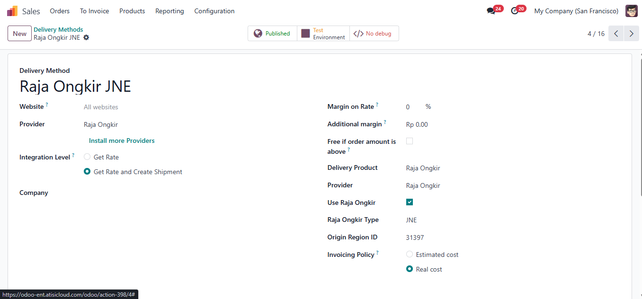
Setting Up Raja Ongkir Integration
1
3
Odoo
Hub
2
4
Use Raja Ongkir & Select Courier

Slide 17
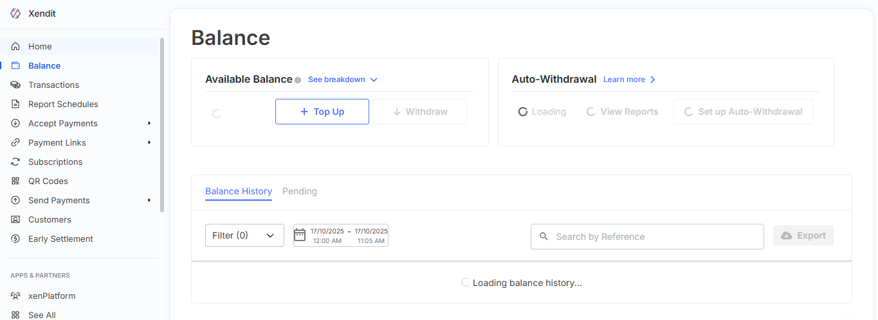
Xendit Payment Gateway
Xendit is a payment gateway platform that enables seamless online payments across Indonesia. It supports multiple payment methods such as virtual accounts, e-wallets, credit/debit cards, and QRIS. By integrating Xendit with Odoo, businesses can automate the payment process during checkout allowing instant payment validation, automatic invoice generation, and real-time transaction updates inside the ERP system.
Odoo
Hub

Slide 18
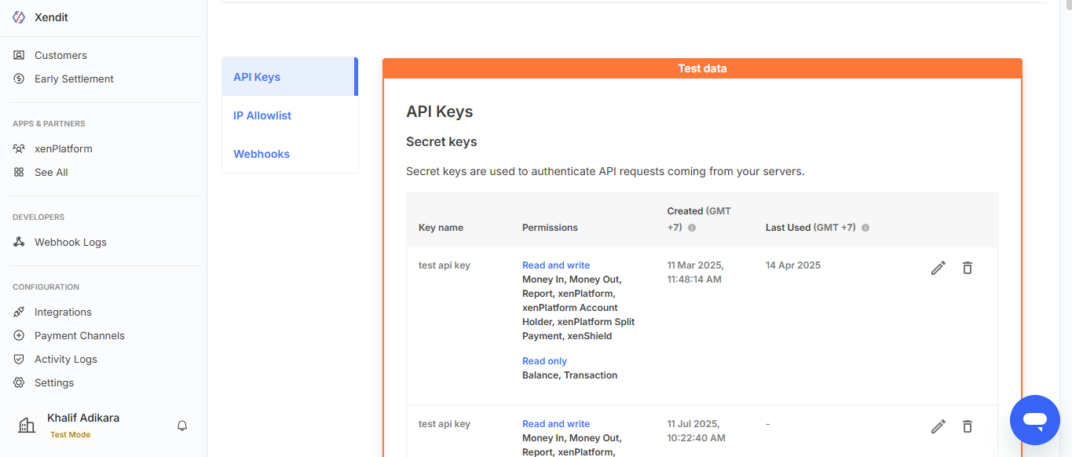
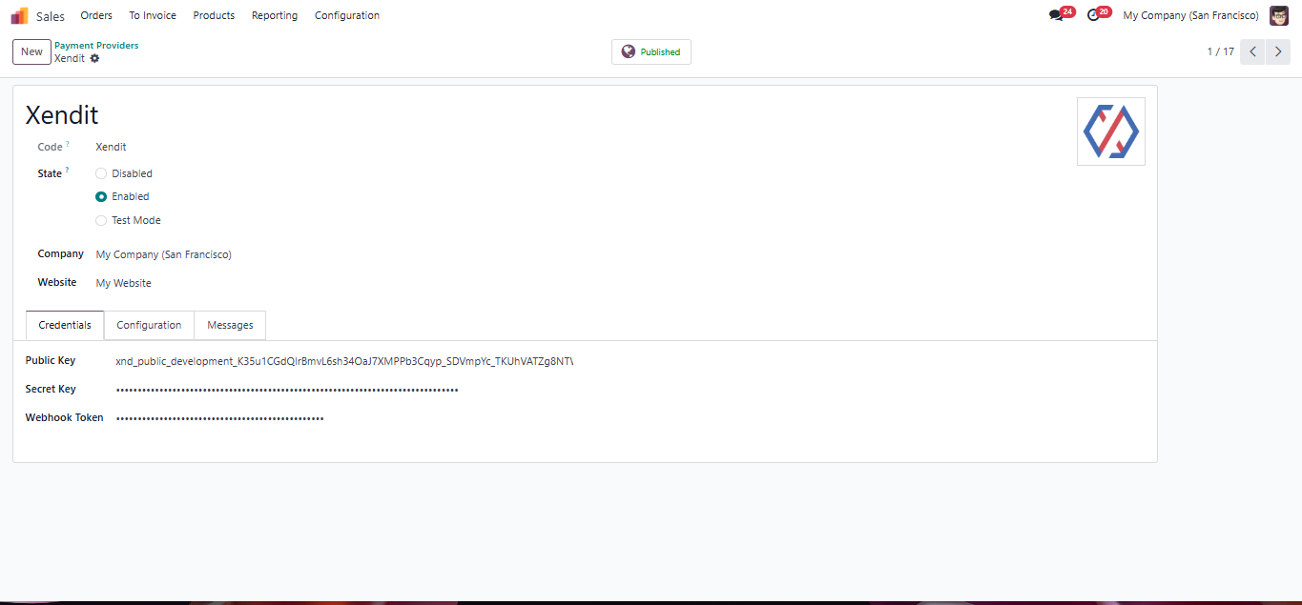
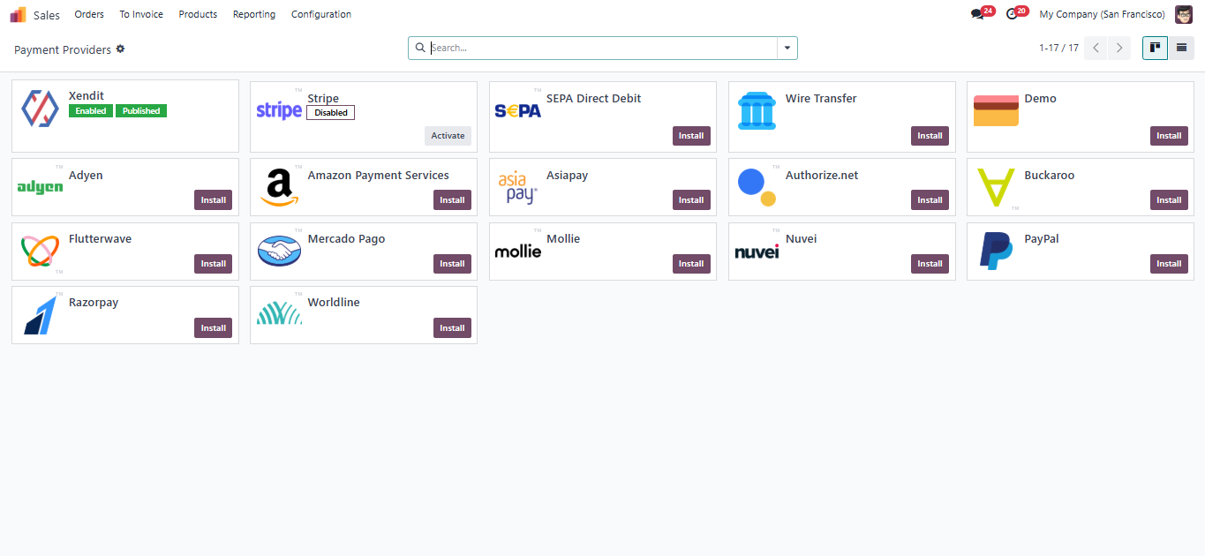
Setting Up Xendit Integration
1
3
Insert API Key & and webshook
2
Once configured, Xendit will appear as a payment method at checkout.

Slide 19
Xendit Payment Gateway
Xendit is a payment gateway platform that enables seamless online payments across Indonesia. It supports multiple payment methods such as virtual accounts, e-wallets, credit/debit cards, and QRIS. By integrating Xendit with Odoo, businesses can automate the payment process during checkout allowing instant payment validation, automatic invoice generation, and real-time transaction updates inside the ERP system.
Odoo
Hub

Slide 20
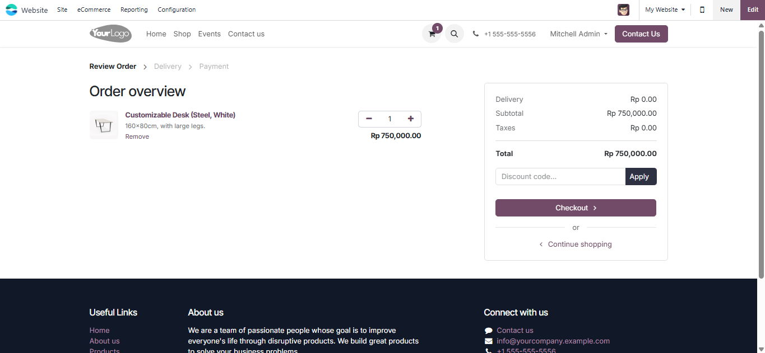
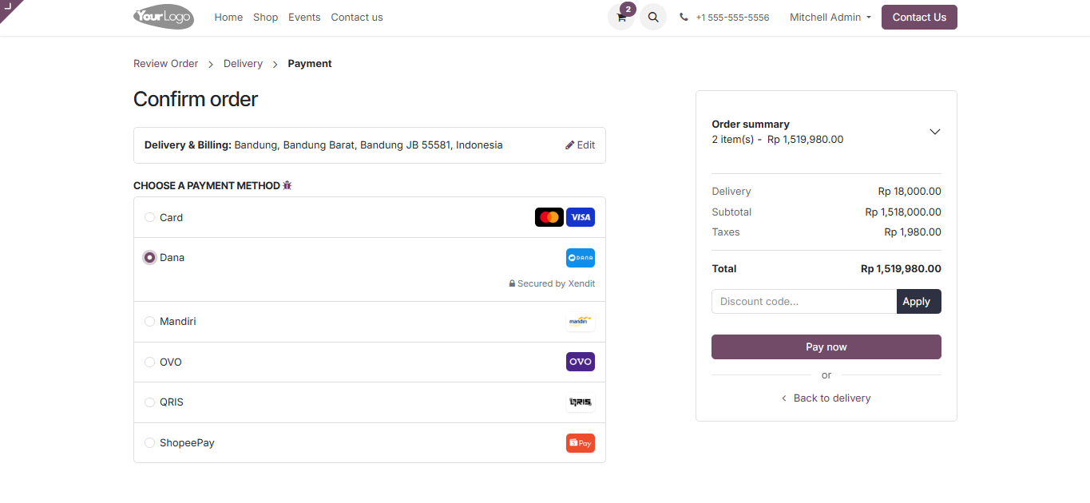
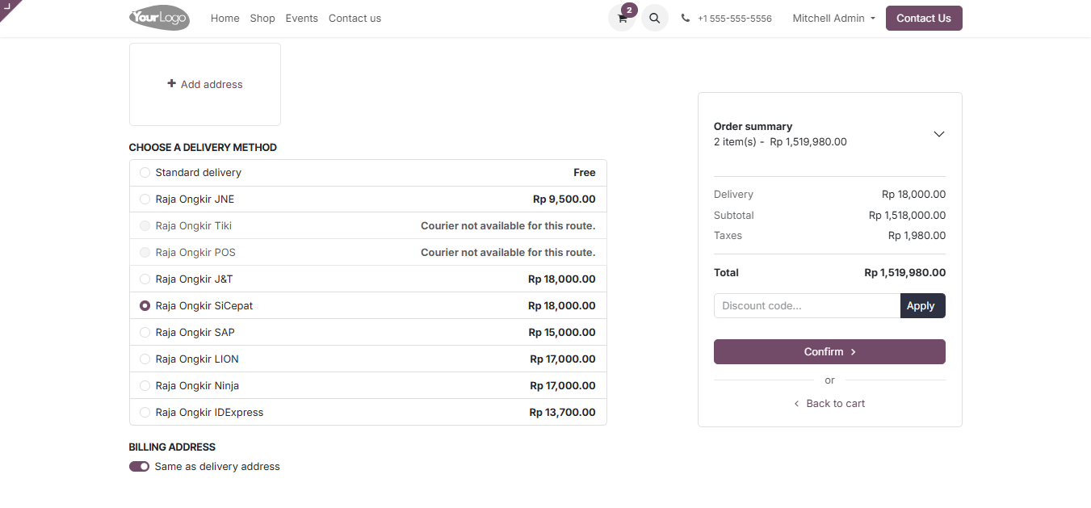
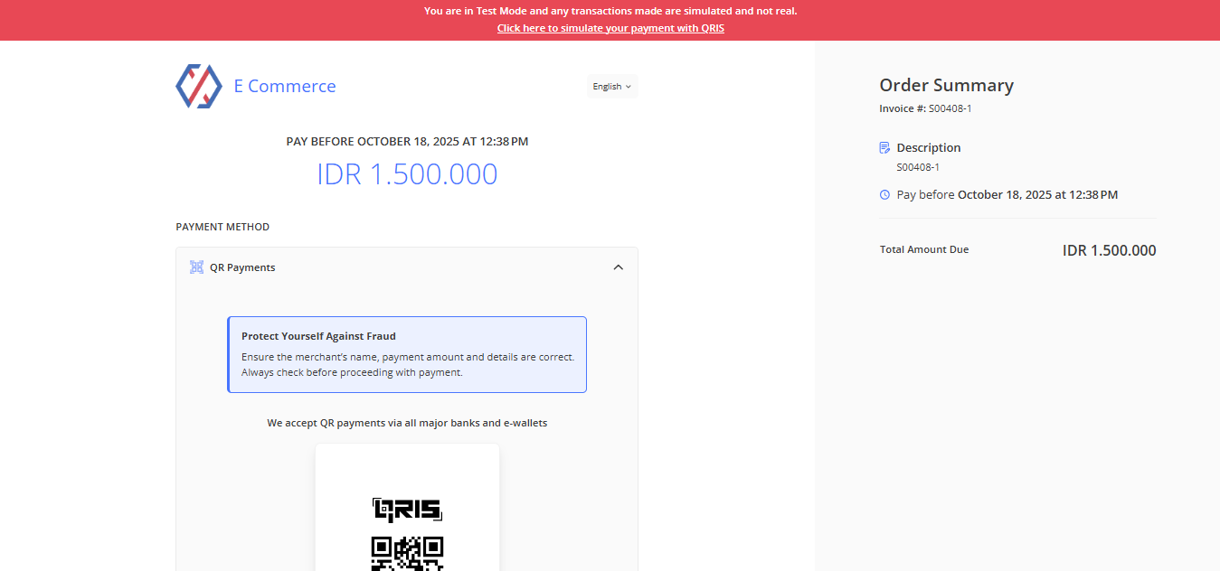
Sample 2 Transaction: Demo Flow End-to-End eCommerce Process
1
3
Xendit Payment Methods
2
4
Raja Ongkir Shipping Costs

Slide 21
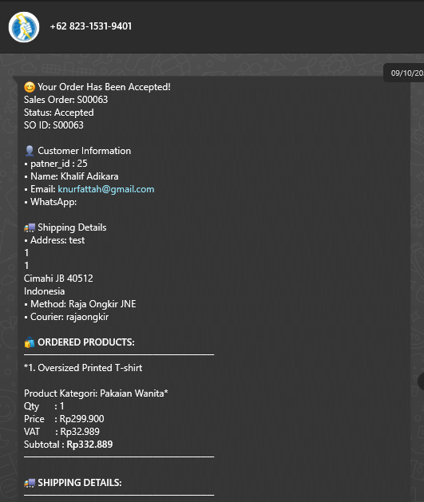
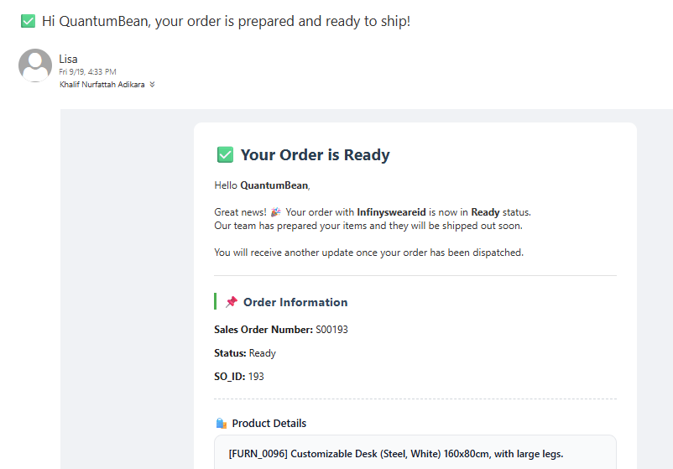
Order Notification
The customer automatically receives a notification email or WhatsApp message (via n8n automation). The WhatsApp messages are sent through the WAHA connector, allowing direct notification integration with Odoo.
1
2
Odoo
Hub

Slide 22
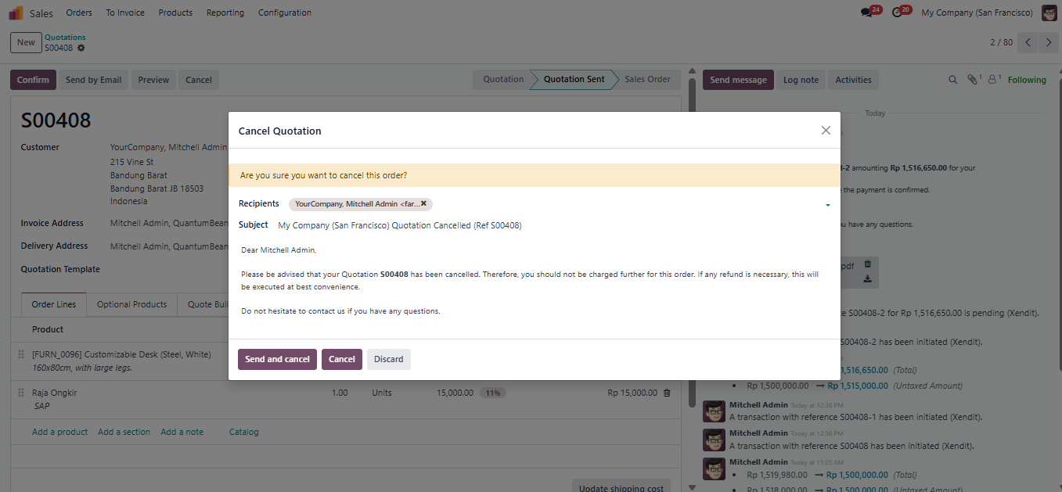
Order Cancelation Process
The order cancellation process in Odoo is handled directly through the Sales module.To cancel an order, the user simply opens the Sales Orders menu, selects the desired order, and clicks the Cancel button. Once the order status changes to Cancelled, the system automatically sends a notification to the customer via email and WhatsApp.

Slide 23
Sample Reporting & Dashboard

Slide 24
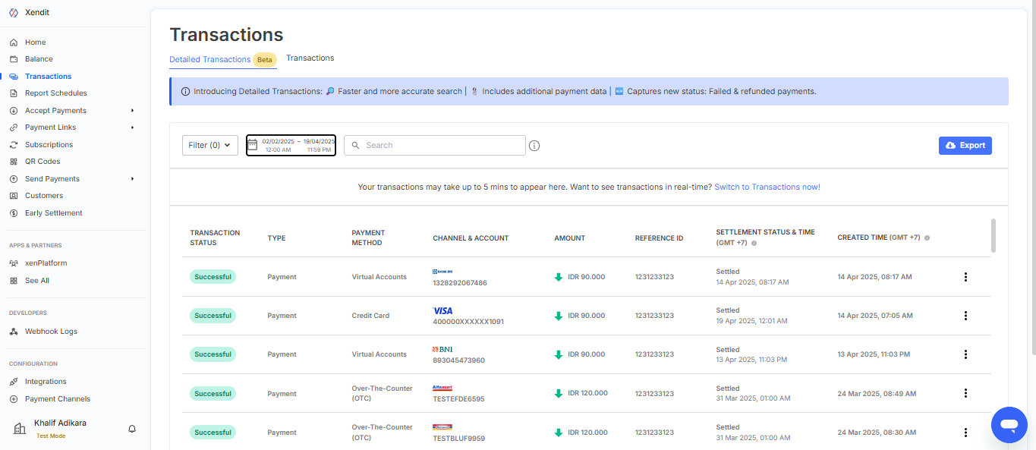
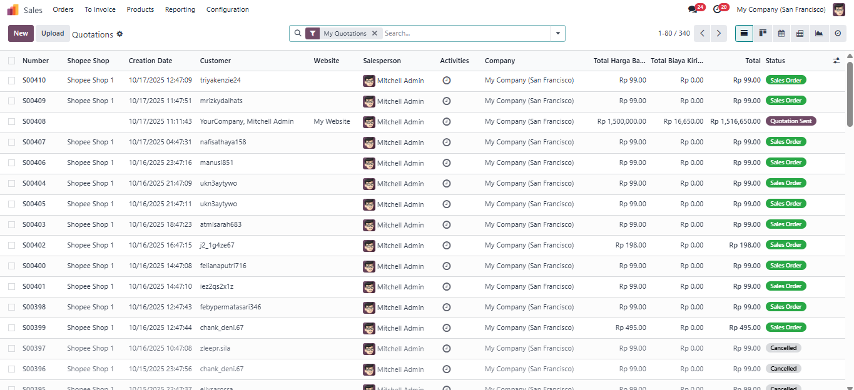
Reporting Sample
For reporting, Xendit and Odoo work together to provide clear financial and sales insights. Through Xendit, users can monitor payment details such as successful transactions, pending payments, and refunds across different channels. Meanwhile, Odoo records all validated payments automatically into its system, allowing businesses to generate accurate reports and reconcile data easily. This integration keeps all financial information consistent and up to date between Xendit and Odoo.
Reporting xendit
Reporting odoo
Odoo
1
2
Hub

Slide 25
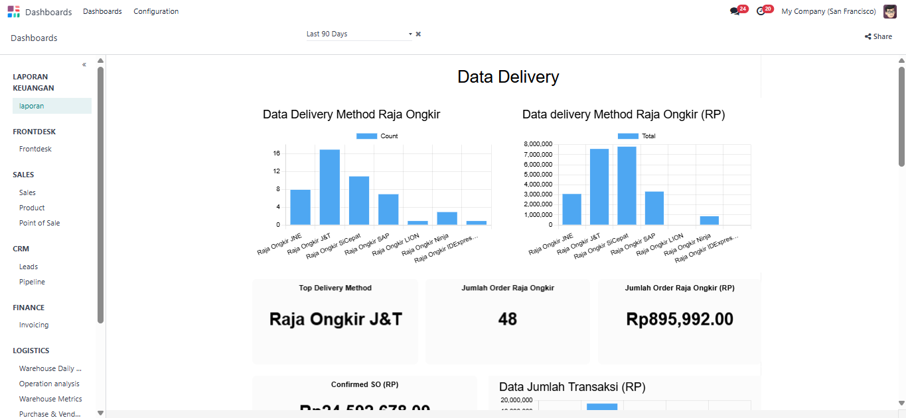
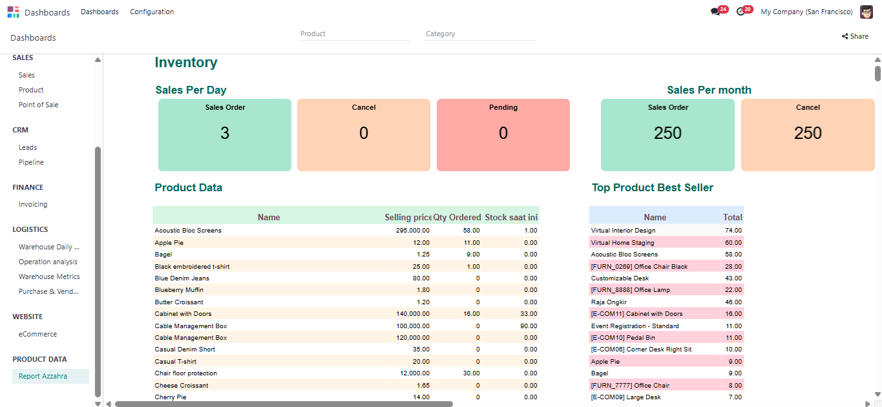
Sample Odoo Dashboard
Sales Dashboard in Odoo provides a real-time overview of sales performance, including total revenue, order status, and top-selling products.
It helps businesses monitor trends, track payment progress, and make data-driven decisions to improve sales strategies. Inventory Dashboard displays stock levels, incoming and outgoing shipments, and product movement across warehouses. With this dashboard, users can easily track item availability, identify low-stock products, and optimize restocking operations efficiently.
Dashboard Sales
Dashboard inventory
Odoo
1
2
Hub

Slide 26







Future-Proofing Your Business
Integrating ERP with eCommerce establishes a scalable foundation for growth in the digital landscape.
Strategic Foundation
Operational Excellence
ERP-eCommerce integration represents a strategic imperative that establishes a scalable and efficient foundation for business growth.
Streamlined operations and enhanced customer experiences drive immediate and long-term competitive advantage.
Looking Forward
This integration empowers businesses to adapt to future challenges while maintaining operational efficiency and customer satisfaction.
Odoo's flexible architecture enables easy adaptation as business needs evolve.
Integrated systems provide real-time insights for data-driven decisions.
Ready to future-proof your business?
ERP-eCommerce integration provides the foundation for sustained growth and adaptability.

